Slide 1
Advanced short circuit preventive mechanism for Electric vehicles
BATCH NO:24
GTE BATCH-III (PROJECT WORK _ PHASE I)

Slide 2
PROBLEM STATEMENT & OBJECTIVE
EVs face safety risks from short circuits and battery imbalance.
Existing systems lack real-time detection and response.
Existing system AI can monitor temperature, current, and voltage.
Embedded systems detect abnormalities in delay..

Slide 3
ABSTRACT
The project proposes an advanced short circuit prevention system for EVs to enhance safety and performance.
Traditional methods like fuses and breaks are too slow and reactive for modern EV needs
It uses high-speed sensing, machine learning, and intelligent control to predict and prevent faults
Advanced components and self-diagnostics enable fast response, real-time monitoring, and auto-recovery.
It predicts risks and suggests productive safety measures.

Slide 4
LITERATURE REVIEW
S.No | Journal Name & Year of publication | Paper title | Existing System fault | Inference
1. | 2024, IEEE Transactions on Industrial Electronics | "Quantitative Diagnosis of Internal Short Circuit for Lithium-Ion Batteries Using Relaxation Voltage" | Delayed fault response | Focuses primarily on diagnosis without providing real-time mitigation strategies for detected faults.
2. | 2024, IEEE Access | "Short Circuit Effects on HV Feeders of Optimally Located Electric Vehicle Fast Charging Stations" | Ground Fault Detection | Addresses stationary systems only; does not factor in dynamic or mobile EV charging scenarios.
3. | 2022, IEEE Transactions on Power Electronics | "An Online Data-Driven Fault Diagnosis and Thermal Runaway Early Warning for Electric Vehicle Batteries" | Fuse Protection | Limited to battery systems; lacks consideration of external factors like environmental conditions.

Slide 5
METHODOLOGY
Design
Data Collection
Model Development
Hardware Implementation
Final Development
Evaluation
Testing
System Integration

Slide 6
Plan for Implementation
Smart Circuit Protection System (Real-Time Monitoring)
Advanced Fault Detection Algorithms (AI-Based Prediction)
High-Speed Solid-State Circuit Breakers (SSCB)
Dynamic Load Balancing & Thermal Management

Slide 7
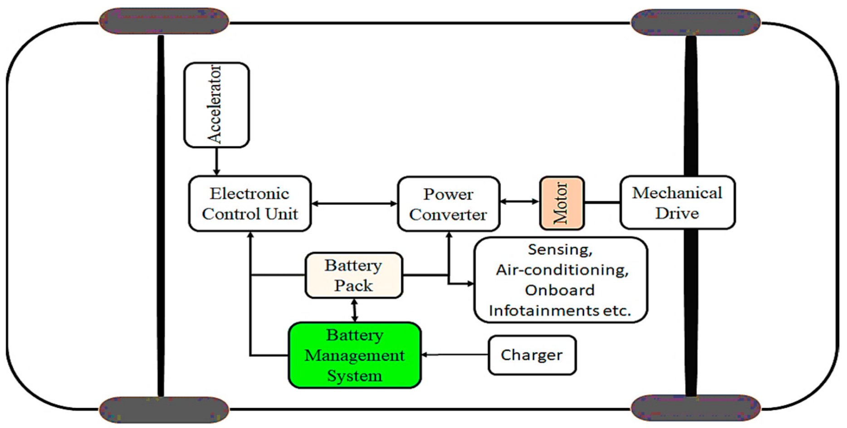
Flow of Proposed Method

Slide 8
Expected Results
Automated Circuit Isolation
Systematic Component Disconnection
Proactive approach
Fault Prediction by continuously Monitoring the electrical Parameters

Slide 9
TEAM STRENGTH
Team Members and Roles –
Subash P (GTE3B2561): Responsible for data collection, and preparing project presentations.
Nathish B (GTE3A2544): Contributed by helping in project documentation.
Sujit M(GTE3B2562): Focused on studying previous research papers to gather useful data, assisted in
presentation work.
Monish B (GTE3A2542): Sensors Specific Datasheet Documentation and Libray file collected
Sarvesh M D (GTE3A2554):Supported for Documentation.

Slide 10
PROJECT PLAN & COST ANALYSIS
Project Phases:
Planning & Research – Topic finalized, basic study completed.
Integration – Sensor logic and setup in progress.
Testing & Refinement – Yet to begin, planned next.
Documentation & Presentation – To be done at the end.

Slide 11
PROJECT PLAN & COST ANALYSIS
Key Milestones & Deliverables:
Week 1–2: Topic finalization, team role distribution, research.
Week 3–4: Select sensors that can accurately detect the mechanism .
Week 5–6: Choose the components to built the kit.
Week 7. : Assemble components and System Integration .
Week 8: Final report, presentation, and documentation.
Communication Plan:
Weekly check-ins for progress updates.
Shared Google Drive for all resources.
WhatsApp group for daily coordination.

Slide 12
PROJECT PLAN & COST ANALYSIS
S NO. | COST CENTER | QUANTITY | RATE PER EACH (IND ₹ ) | APPROX COST (IND ₹ )
1. | SENSORS | 5 | 1000 | 1050
2. | CONTROLLER | 1 | 400 | 500
3. | LITHIUM BATTERY | 4 | 300 | 400
4. | RELAY MODULE | 1 | 50 | 80
5. | SWITCH | 1 | 200 | 200
6. | LCD DISPLAY | 1 | 75 | 75
7. | 5V DC COOLING FAN | 1 | 150 | 175
8. | BMS | 1 | 350 | 350
9. | GSM900A | 1 | 700 | 800
10. | DIODE | 2 | 10 | 30
11. | CONNECTING WIRES | - | 50 | 50
 |  |  | TOTAL | 3710

Slide 13
References
[1] D. Qiao et al., "Quantitative Diagnosis of Internal Short Circuit for Lithium-Ion Batteries Using Relaxation Voltage," in IEEE Transactions on Industrial Electronics, vol. 71, no. 10, pp. 13201-13210, Oct. 2024,doi: 10.1109/TIE.2023.3342289.
[2] D. Walch, A. Geiger and C. Sültrop, "Inter-Turn Short Circuit Faults and Mitigation Measures for Dual-Three Phase Machines," 2024 International Conference on Electrical Machines (ICEM), Torino, Italy, 2024, pp. 1-7, doi: 10.1109/ICEM60801.2024.10700240.
[3] I. Husain et al., "Electric Drive Technology Trends, Challenges, and Opportunities for Future Electric Vehicles," in Proceedings of the IEEE, vol. 109, no. 6, pp. 1039-1059, June 2021,doi: 10.1109/JPROC.2020.3046112.

Slide 14


